Slide 1
P-25: Analysing Yelp Reviews using NLP techniques
Shah Haard Prashant (CSCI 6509)
Nishant Amoli (CSCI 6509)

Slide 2

Why this topic?
If 100 restaurants started this year, only 40 would survive till 2021.
Till 2025, 80% of those restaurants would be closed [1].
Restaurant industry is a rapidly growing industry and has fierce competition.
The primary reason for closing is the lack of self awareness [2].
Hence knowing what they are doing wrong could greatly help to correct and save the business.

Slide 3

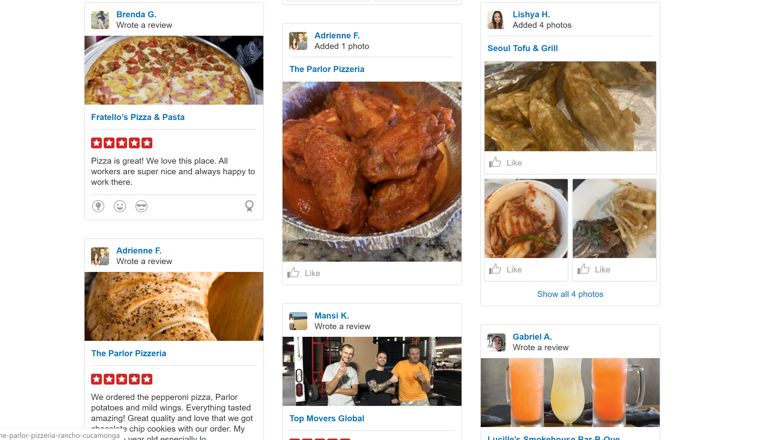
What About the dataset?
Yelp has a huge collection of reviews. Of various businesses as shown in image [3].
Our interest is in restaurant business.
If a business owner can go through reviews and decide what is bad and what is good, then why use NLP?
Problem: Number of reviews is so large that it becomes tedious and almost impossible to decide.
Hence, applying topic modelling techniques of NLP can help.

Slide 4
Steps
Load data in mongo server and extract it through python script and jupyter.
2. Analyse the data and extract relevant restaurant information.
3. Clean the extracted data.
4.Remove the stop words and perform TF-IDF.
5. Apply topic modelling techniques like LDA, NMF.
6. Visualize the result.

Slide 5
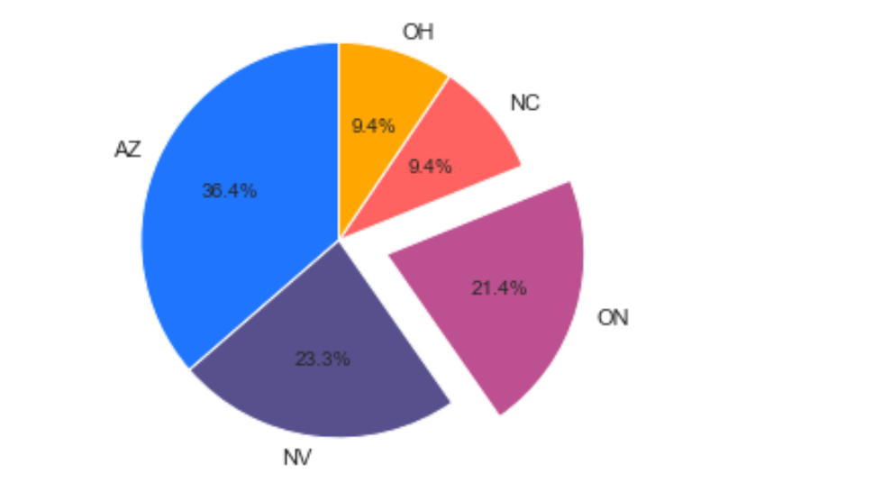
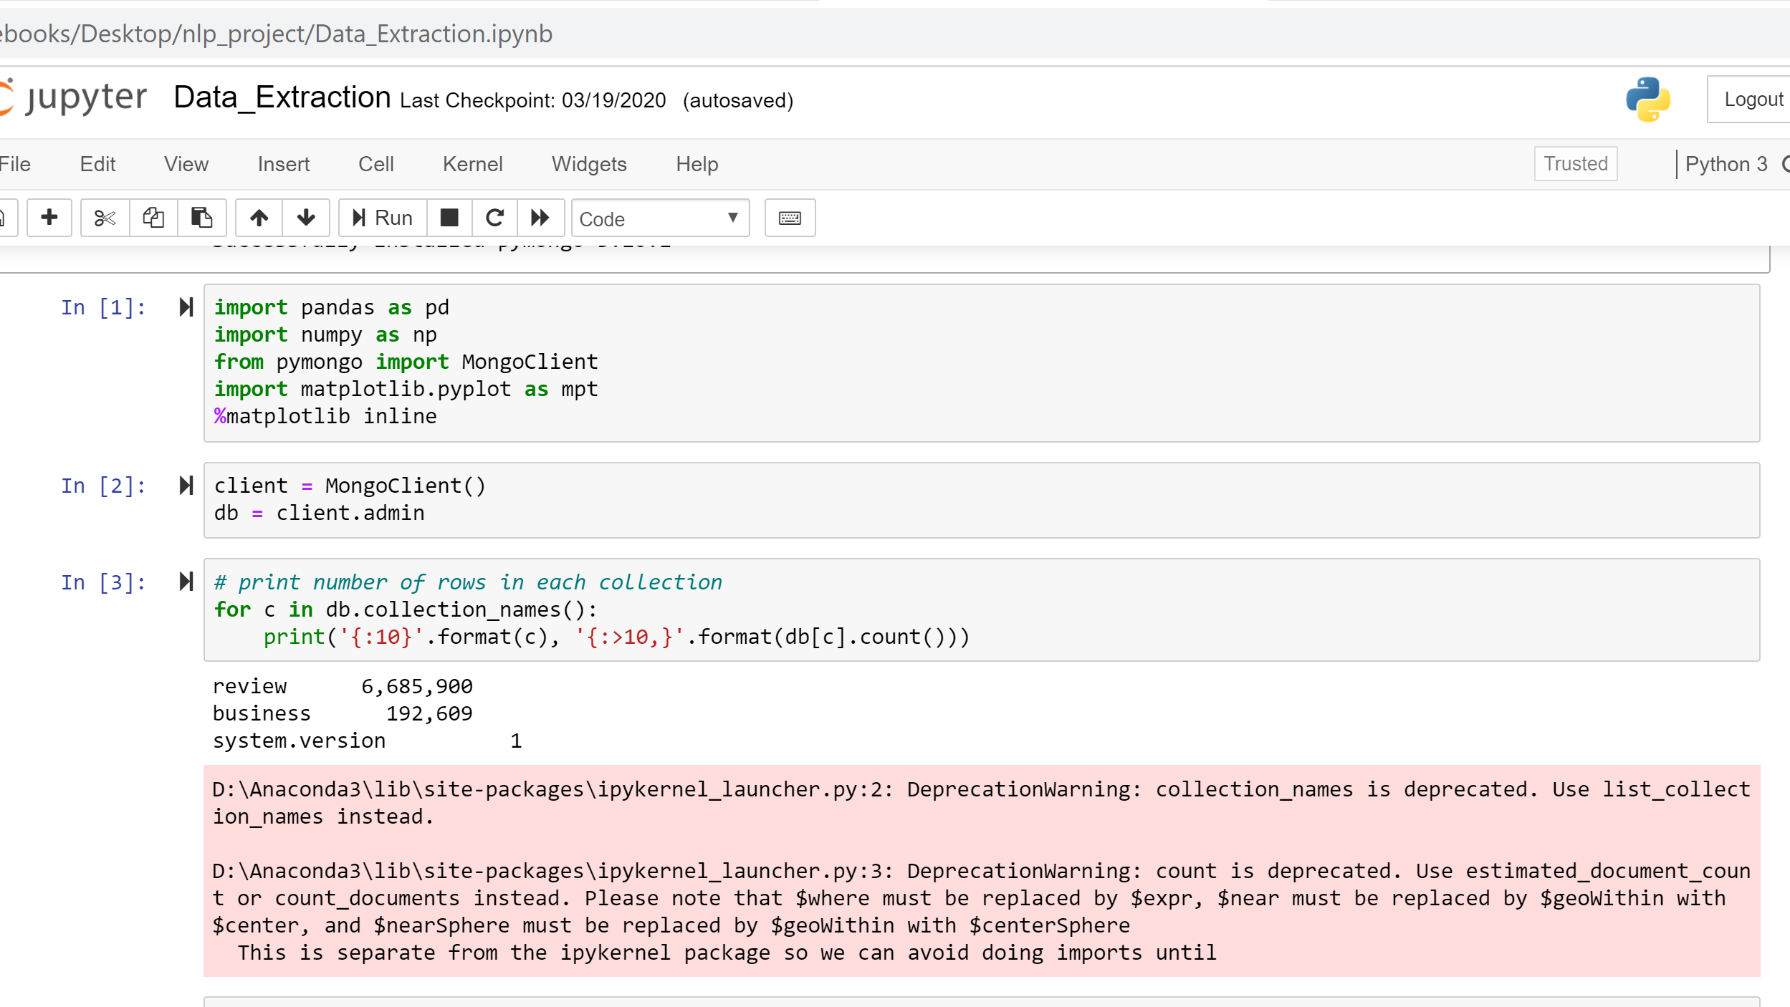
Extracting and Analyzing data
6.6 million reviews of 192,000 restaurants in total.
21.4 % of those reviews are from Ontario province.
Selecting Ontario for further analysis.

Slide 6
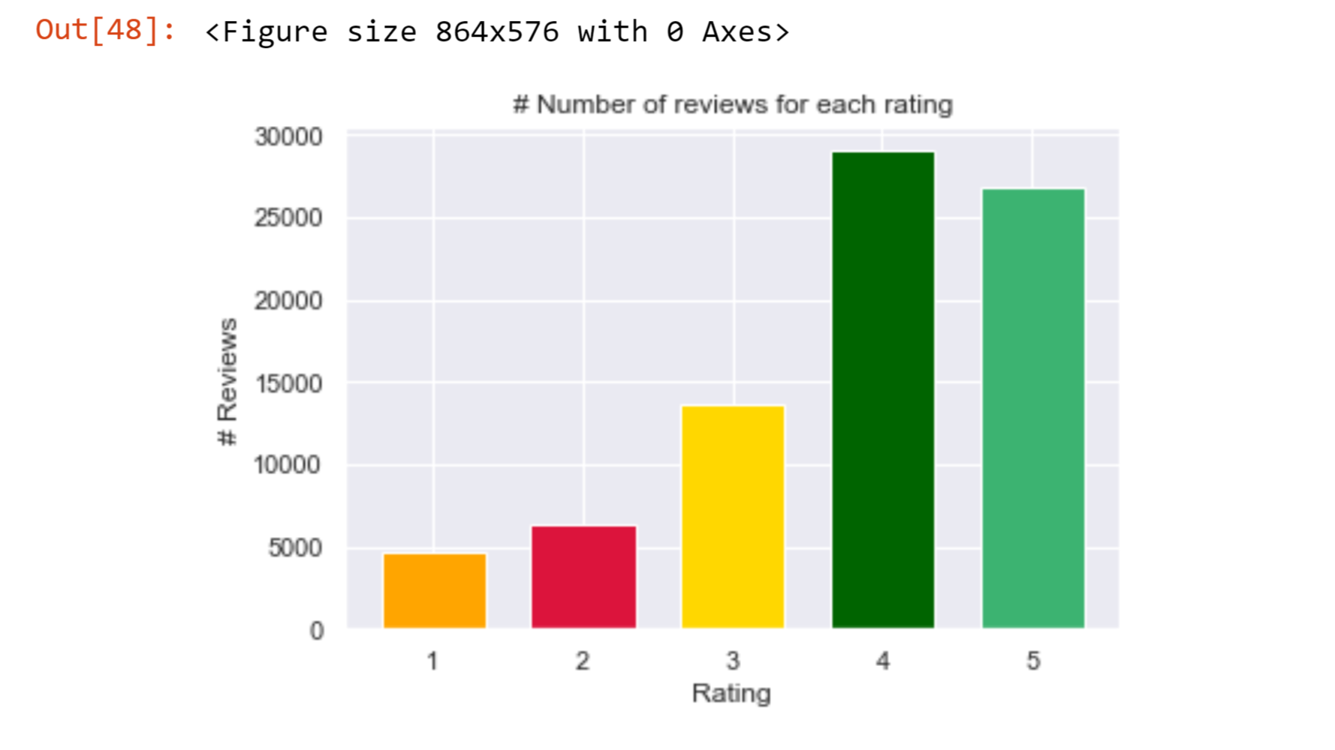
Classifying the reviews
Businesses with > 300 reviews.
3-Categories.
1/2 stars: negative review topic modelling.
3 stars : average review topic modelling.
4/5 stars: used for positive review topic modelling.

Slide 7
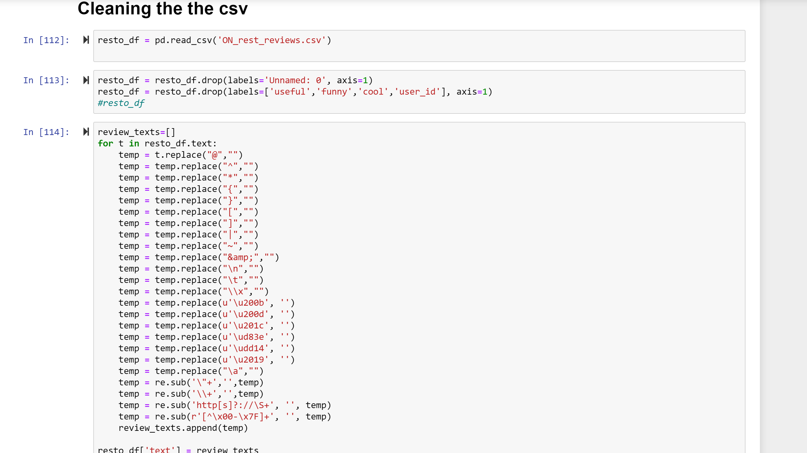
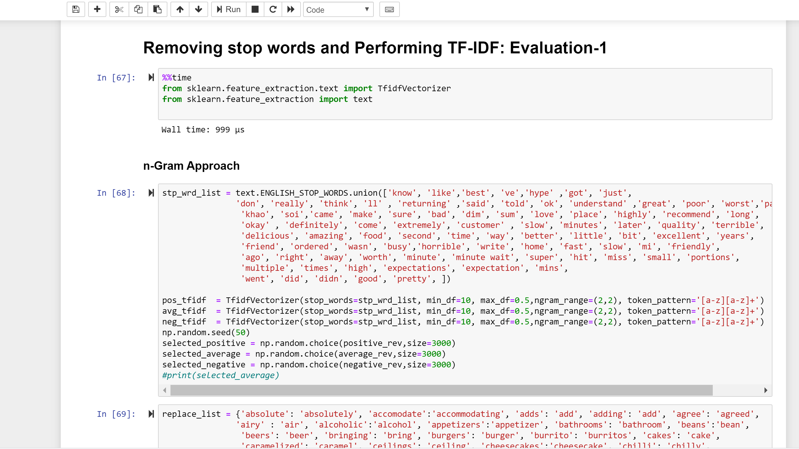
Cleaning, Stop-words removal and tf-idf
The reviews were cleaned for URL's , special characters.
The standard collection of stop words is not sufficient for reviews and hence we included more frequent stop words that would appear in reviews and are not useful.
1-gram approach = ‘ice’.
2-gram approach = ‘ice cream’.

Slide 8
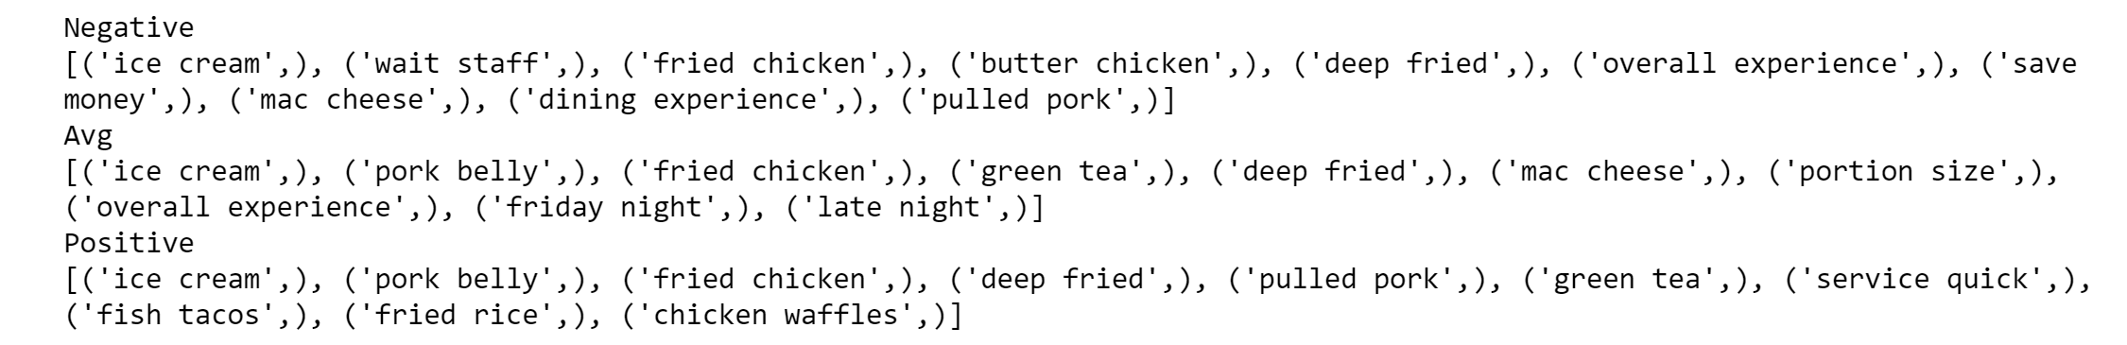
TF-IDF Mean Words
The image shows mean of all similar topics and selecting top 10 from them.

Slide 9
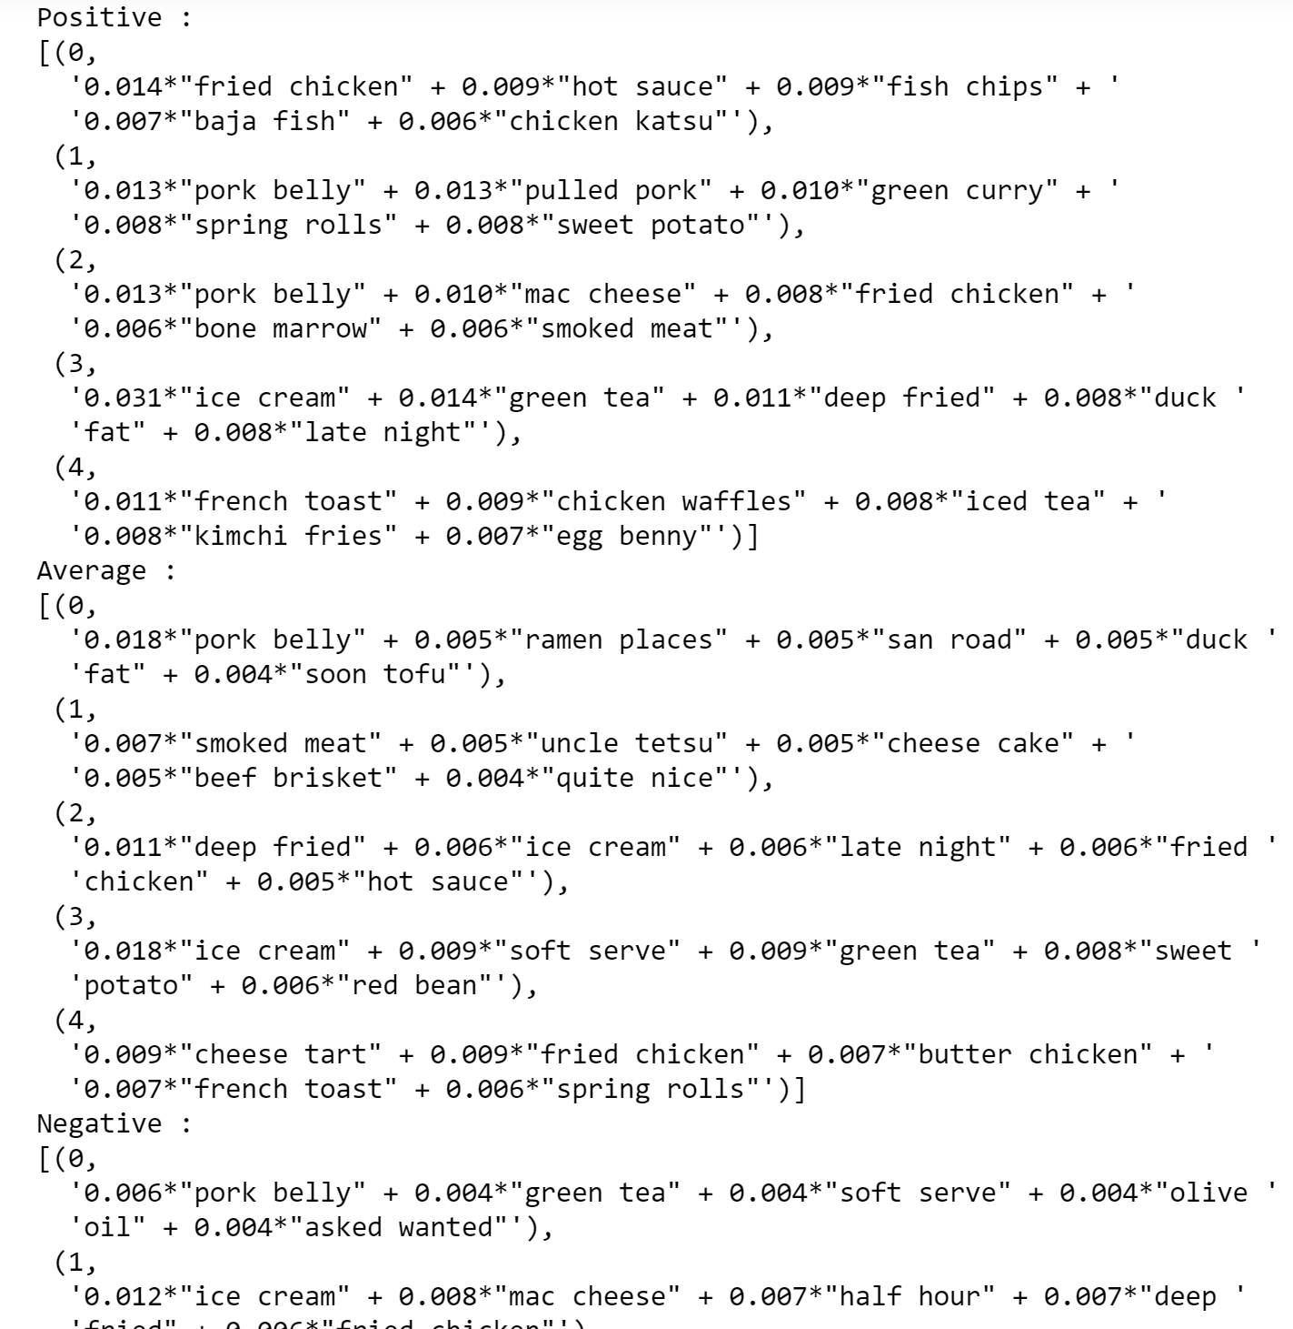
LDA TOPICS
LDA topic modelling done using count vectorizer - id2word.
Wall time: 3mins 8 sec using multicore with 10 passes and 15 workers.
Topic weights are not great for interpretation.

Slide 10
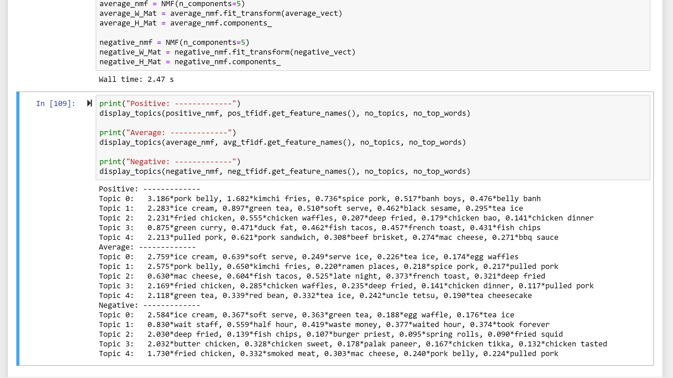
NMF topic modelling
More interpretable topics.
More even distribution of weights.
Convertible to visualization.

Slide 11
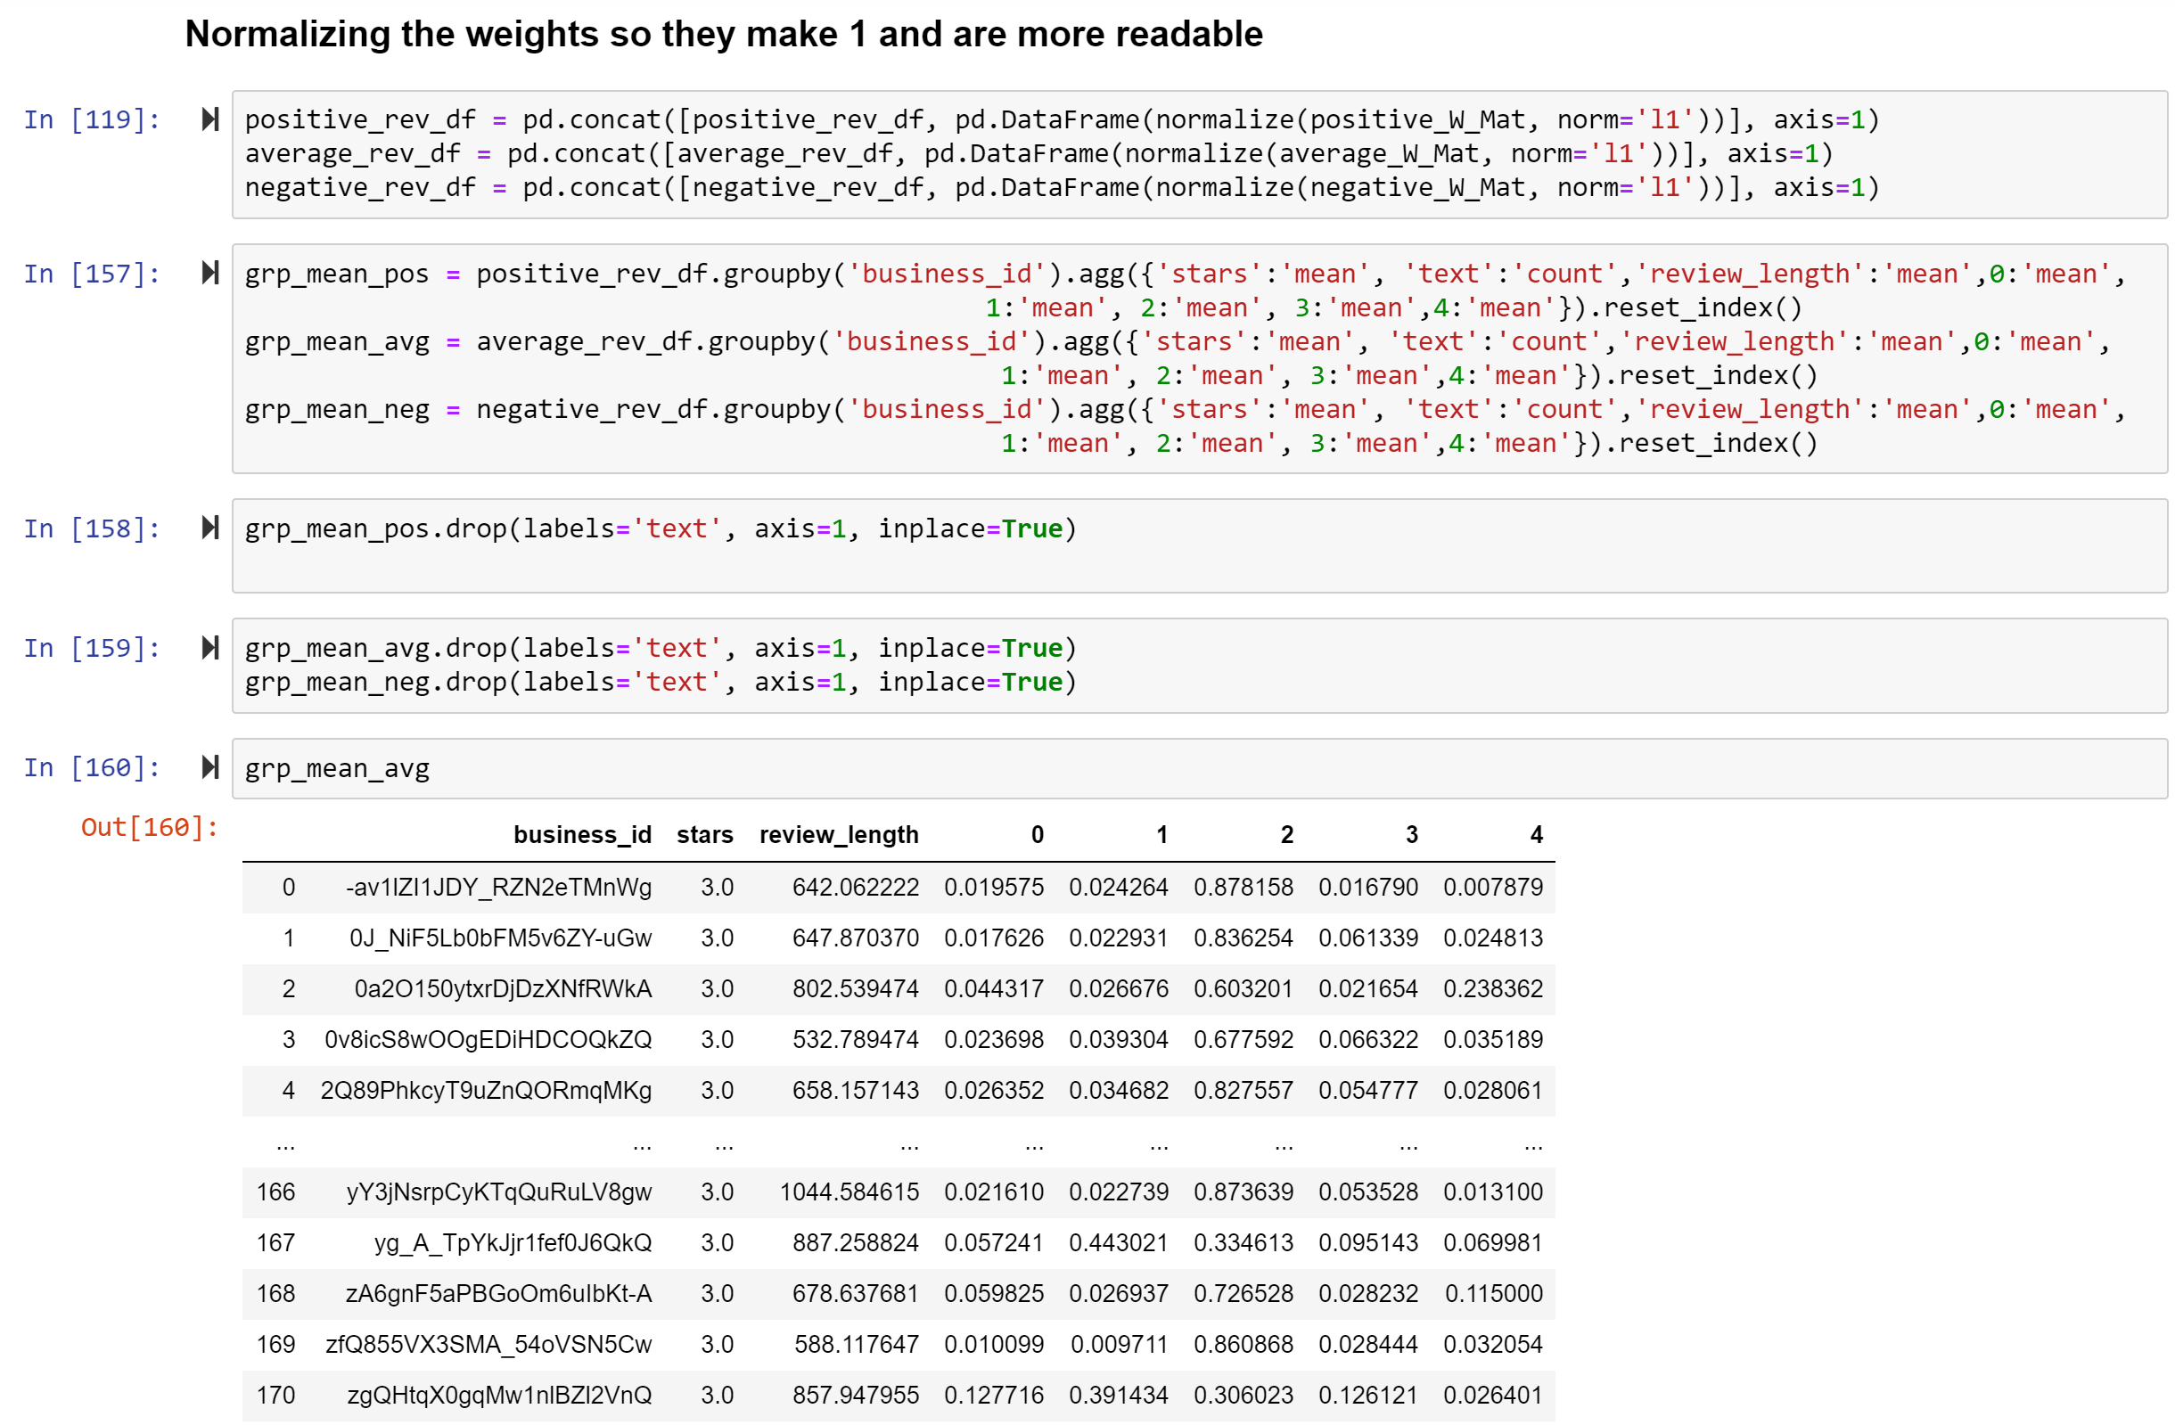
Normalizing and Mapping
Normalized the topic weights so they add up to 1.
Mapped the topics weights to each restaurant.
The sample is of average reviews, similarly for positive and negative.

Slide 12
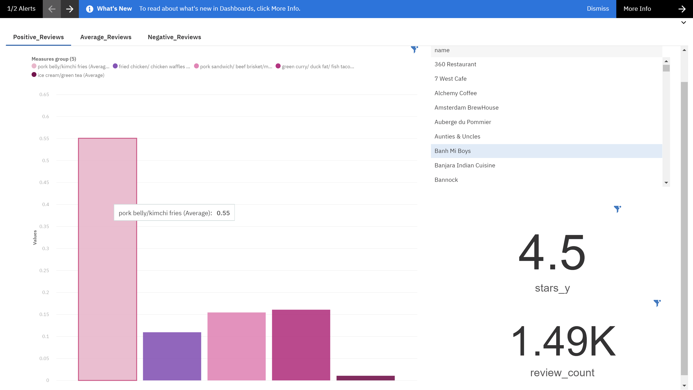
Visualizing Results : Positive reviews

Slide 13
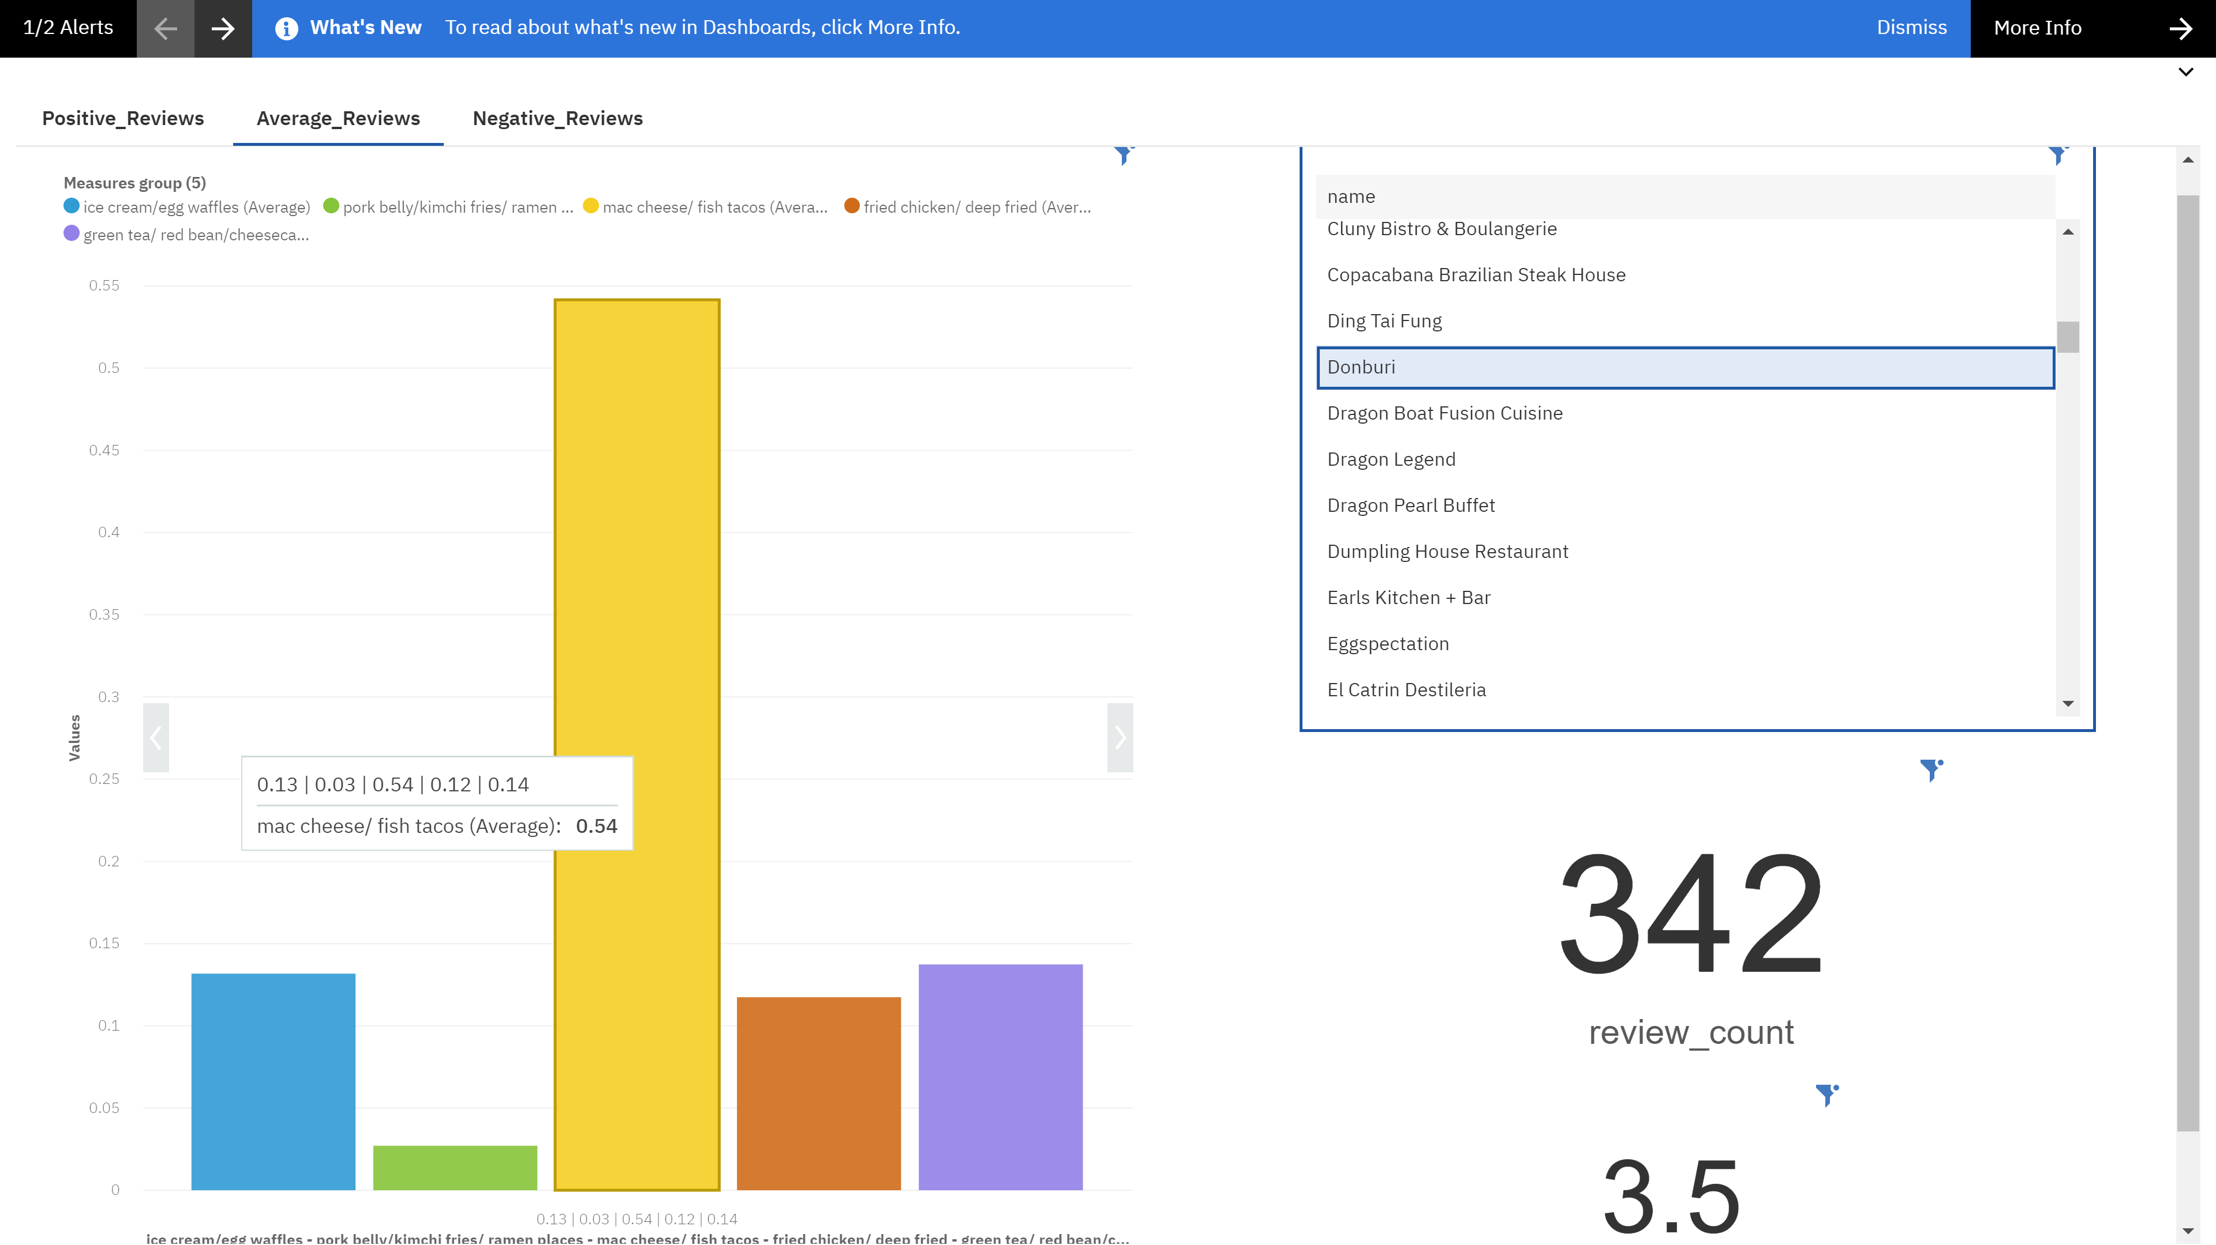
Visualizing Results : Average reviews

Slide 14
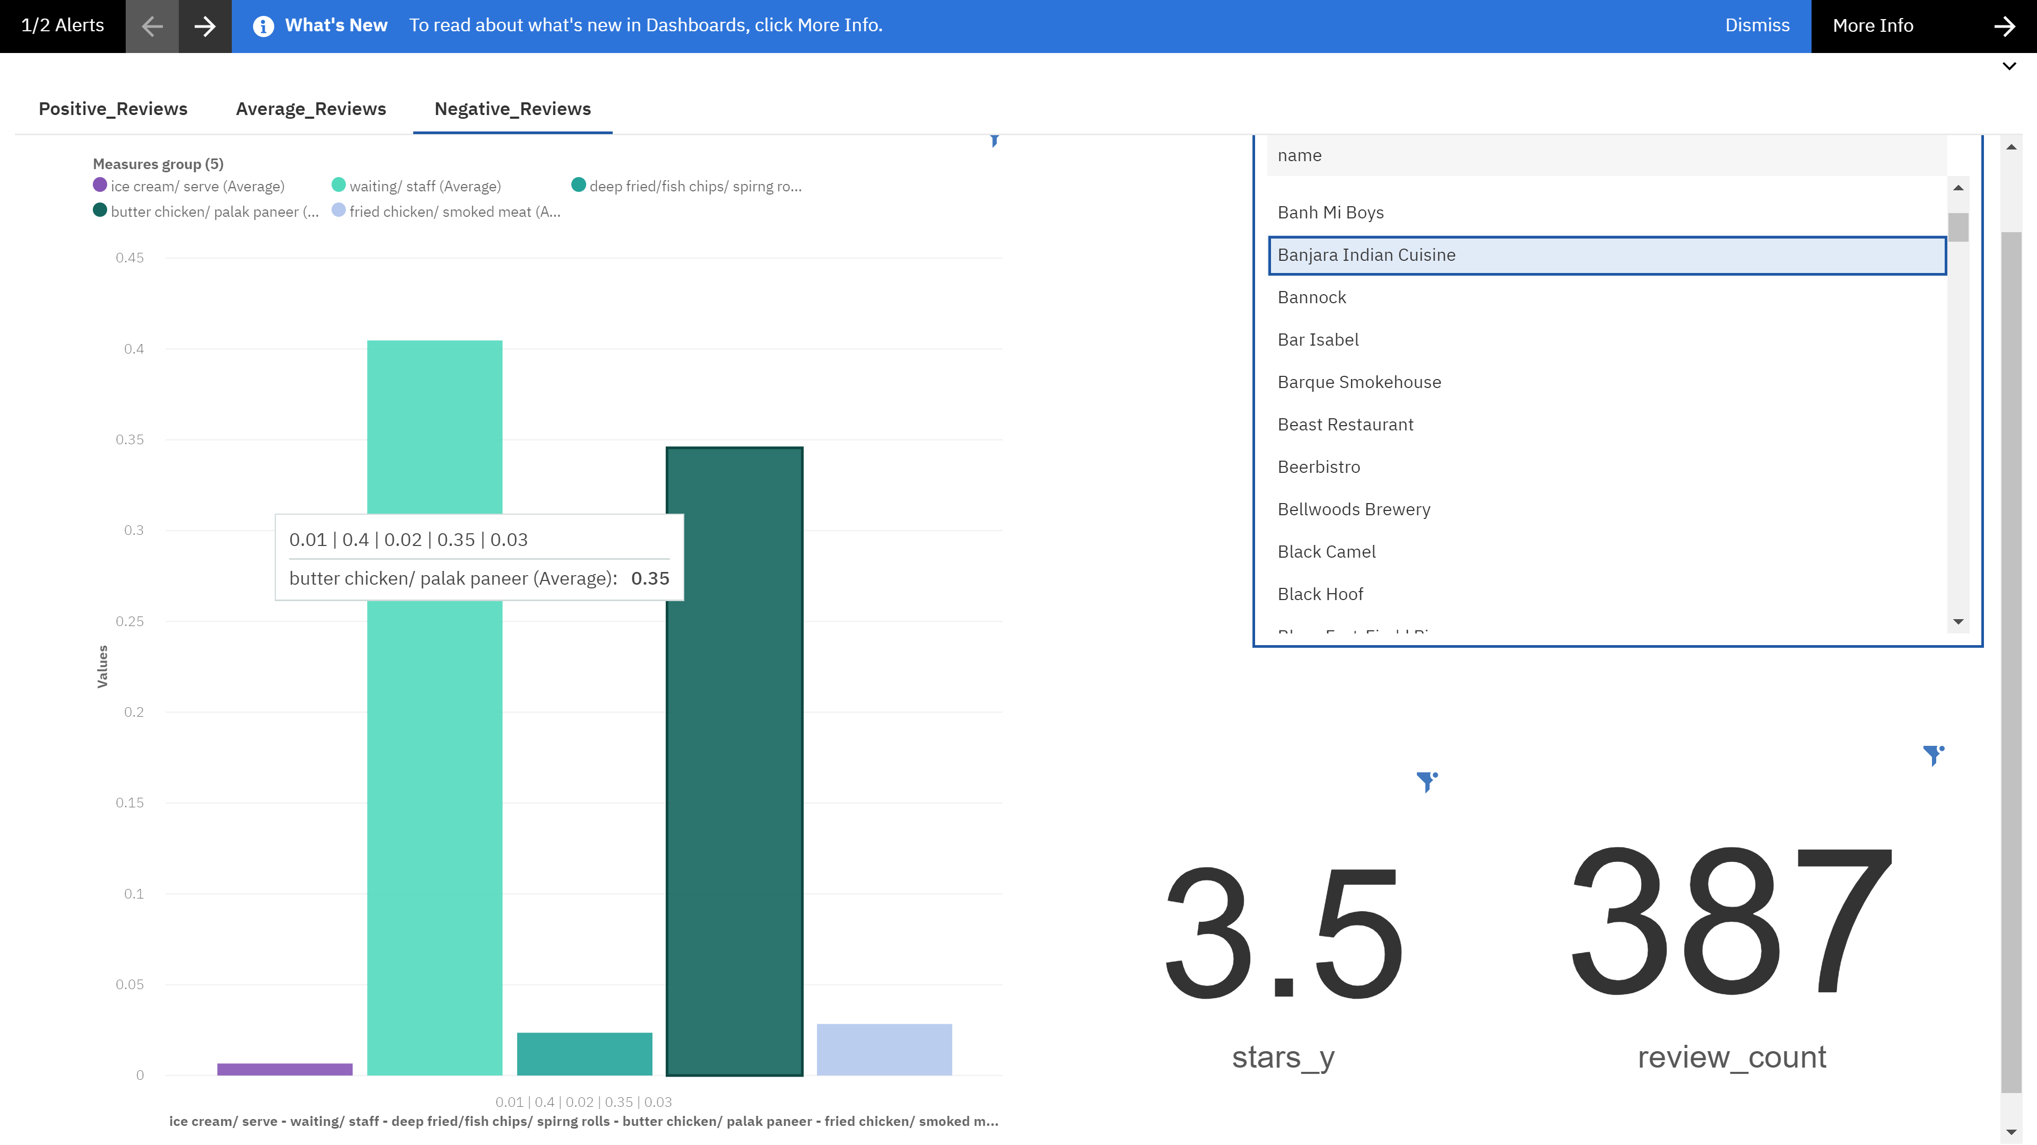
Visualizing Results : Negative reviews

Slide 15
Future work
Get individual topic for each restaurant and analyse.
Instead of directly separating the reviews based on stars, perform sentiment analysis to get the relative polarity of reviews.

Slide 16
References
[1] H. Parsa, J. Self, D. Njite and T. King, "Why Restaurants Fail", Cornell Hotel and Restaurant Administration Quarterly, vol. 46, no. 3, pp. 304-322, 2005. Available: 10.1177/0010880405275598.
[2] J. Bellini, "The No. 1 thing to consider before opening a restaurant", CNBC, 2020. [Online]. Available: https://www.cnbc.com/2016/01/20/heres-the-real-reason-why-most-restaurants-fail.html. [Accessed: 02- Apr- 2020].
[3] Yelp.ca, 2020. [Online]. Available: https://www.yelp.ca/halifax. [Accessed: 02- Apr- 2020].

